Slide 1
String Pattern Matching
Team 10
Yasin Zahir Emmanuel Bruce Loh

Slide 2
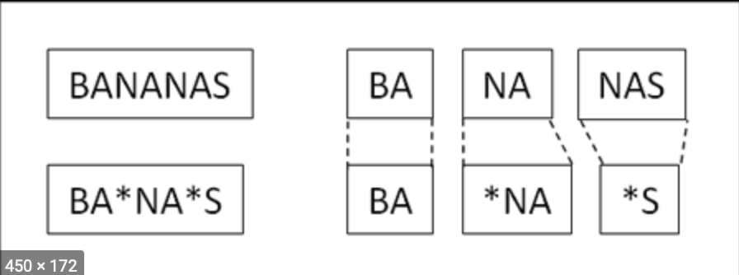
What is “String Pattern Matching”?
Definition:
Naive/Brute Force VS Rabin-Karp
Time complexities
Our application needing brute force for efficiency
More examples of real life applications of all three
A little about Knuth-Morris-Prath algorithm

Slide 3
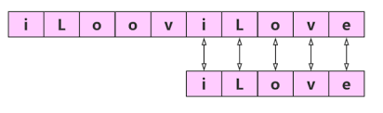
Naive/Brute Force Algorithm
Text: “Computer Science”
Pattern/user input: “Compdter Science”
The pattern/user input would check the text beginning with each character until the typo at ‘d’. It would take 5 comparisons to see the error. [3:6]

Slide 4
Naive/Brute Force Time Complexity
O(M*N)
What is M?
The size of the pattern
When would you need this?
If looking to see how many occurances of matches you get within comparing two strings [10: 3]
What is N?
The size of our main String being compared to other strings

Slide 5
Naive/Brute Force Real Life Application
Since this is the most simple algorithm
We can use it to sort through every single character, array index, ect.
Knowing this, its best to use it for small sample size problems
Such as matching searches or looking for patterns within smaller databases [2:4]
Application in Passwords
Why?
No need for backing up to restart again after initial mismatch

Slide 6
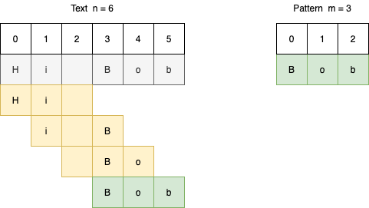
Rabin-Karp Algorithm
Text: “YYYYYYYYYYZZ”
Pattern: “YYYYYZ”
Rather than the Brute Force algorithm of checking each individual char…
We use a sliding window of 6 values and check the first and last ‘Y’ & ‘Z’ to see if its a match, we continuously move in groups of 6 until we find a match of the first and last values. [7:2]

Slide 7
Rabin-Karp Time Complexity
Time complexity is: O(M*N)
Same as brute force, as we must inspect every char
only difference is this is done after we find a match with the first and last char, incrementation is still by 1 though just like naive algorithm [5:6]

Slide 8
Rabin-Karp Real Life Application
Although slightly better than the brute force algorithm, we are still incrementing by only one character, we can use this algorithm to find slightly larger patterns with strings that are quite erratic and don’t have many repeating instances of characters [8:3]
You can use it for searching for words within a longer list of sentences but not too large like a dictionary
We are still incrementing by only 1 character

Slide 9
Knuth-Morris-Prath Algorithm
Text: “ **ACDGFJ----------------* “
Pattern: “ACDGFJPPP”
Here instead of looking at the first and last values, we simply look at how many instances of correct matches we get after reaching our first mismatch. [3:9]
Here it is 7, while we look at pre mismatches it is 2
So 7-2 will give us 5. We shift 5 spaces and continue the process until we finish seeing there is not match between the text and pattern.

Slide 10
Knuth-Morris-Prath Time Complexity
O(M+N)
This only applies while we use the first initial stage of calculating the first shift then it is O(N)
What is N?
The size of our main String being compared to other strings
The main takeaway here, is that we can see incrementation is much larger than the last two algorithms and it allows for never backtracking to find search results, and it is much quicker [8:4]

Slide 11

Knuth-Morris-Prath Real Life Application
We can see that when looking for patterns within larger data set, the processing is only done once for KMP rather than brute force, as it continually shifts with the (correct match number - prefix mismatches). [4:6]
It would be good to find sentences rather than words or phrases within paragraphs or any large scale string pattern within a giant search.
Of all 3 algorithms this would be best for looking for patterns of DNA base pairing
ACGTGCGTACT for example within large strands of DNA

Slide 12
What is our application and what did we use
Created an application that matched the students major to his needed coursework
How was this achieved?
By using the most efficient algorithm
Naive/Brute Force
Why?
Easier to apply to a smaller database [5:2]
Does not require extensive coding

Slide 13
The process behind the set up
The first step was in finding a set of majors
Specifically from CSUN and a few other colleges
This was done to create our database of courses
Secondly we had a student enter a user input of his major
Our function titled compare() then checked each character of the string to see if matched with each of the majors
Until there was one left that matched entirely

Slide 14
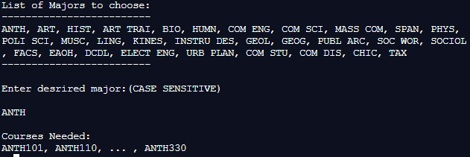
The result of the application
What was the outcome of the application?
After the user input we had a list of the coursework needed for the student to take
How else can we use a naive/brute force algorithm?
By comparing password combinations to ensure validity
How fast and efficient is our application?
Build time is: 340 milliseconds

Slide 15
Relevance of our application
When taking a look at a smaller dataset
A naive/brute force algorithm can help speeden the productivity and efficiency of a search program
The differentiation between this and other programs
Our program prioritizes productivity speed without compromising efficiency in coding
This code can contribute widely to newly graduated high school students who may need to continuously check between other majors to see what major they may be interested in

Slide 16
How can we expand on our application
We can take a step further by adding a review feature to our application
Which has not been done before on CSUN application
If the data set is significantly larger
We can survey students who have taken certain courses and have them give a rating out of 5 stars
The average taken after the survey can introduce a new feature where we look at the reviews and have students not only input their major but also courses and see which are the best rated

Slide 17
References
A. Mohammad, O. Saleh, and R. A. Abdeen, “Occurrences Algorithm for String Searching Based on Brute-force Algorithm,” PDFS Semantic Scholar. [Online]. Available: https://pdfs.semanticscholar.org/a5b8/4d36d95eb56586e34552290ce5dce59ef96f.pdf. [Accessed: 11-Nov-2020].
“Analysis of Algorithms,” CSD UWO. [Online]. Available: https://www.csd.uwo.ca/courses/CS1027b/notes/CS1027-017-Analysis-W12.pdf. [Accessed: 10-Nov-2020].
“CS 440 Theory of Algorithms / CS 468 Algorithms in Bioinformatics,” CS Winona. [Online]. Available: https://cs.winona.edu/lin/cs440/ch03.pdf.
G. Gimel’farb, “String Matching Algorithms,” CS Auckland . [Online]. Available: https://www.cs.auckland.ac.nz/courses/compsci369s1c/lectures/GG-notes/CS369-StringAlgs.pdf. [Accessed: 10-Nov-2020].
K. Moore, A. Chumbley, and J. Khim, Brilliant. [Online]. Available: https://brilliant.org/wiki/rabin-karp-algorithm/. [Accessed: 10-Nov-2020].
M. Cao, “Time Complexity of Knuth-Morris-Pratt String Matching Algorithm,” EECS Tufts. [Online]. Available: http://www.eecs.tufts.edu/~mcao01/2010f/COMP-160.pdf. [Accessed: 10-Nov-2020].
P. Shah and R. Oza, “Improved Parallel Rabin-Karp Algorithm Using Compute Unified Device Architecture,” Arvix. [Online]. Available: https://arxiv.org/abs/1810.01051. [Accessed: 11-Nov-2020].
R. Sedgewick and K. Wayne, “Substring Search,” ES Princeton. [Online]. Available: https://www.cs.princeton.edu/courses/archive/spring14/cos226/lectures/53SubstringSearch.pdf. [Accessed: 11-Nov-2020].
“Strings And Pattern Matching,” CS Purdue. [Online]. Available: https://www.cs.purdue.edu/homes/ayg/CS251/slides/chap11.pdf. [Accessed: 10-Nov-2020].
VCU, Ed., “The Brute Force Algorithm,” People. [Online]. Available: http://www.people.vcu.edu/~gasmerom/MAT131/brutefrc.html.

